Slide 1
Applying for Grad School: The Hard But Rewarding Journey
Keaton Donaghue
kdonaghu@umd.edu
KU REU and JUST Program Grad School Workshop
7/30/2024

Slide 2
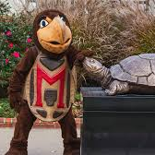
Brief Aside of Who I Am (why I sort of know what I'm talking about)
Just graduated from the University of Kansas studying physics and astronomy
Previous president of the Society of Physics Students and UG representative for the department. My research focused on nearby galaxies under the direction of Dr. Mills
Applied last cycle to 12 schools
Got 3 acceptances and 3 waitlists
Accepted my offer to go to UMD for an astronomy Ph.D.
Also received an NSF GRFP

Slide 3

Why You Should Apply?
In no particular order
You want to stay in academia.

Slide 4
Why You Should Apply?
In no particular order
You want to stay in academia.
You want to be a professor.

Slide 5
Why You Should Apply?
In no particular order
You want to stay in academia.
You want to be a professor.
You want to work in a national lab full time (as a researcher).

Slide 6
Why You Should Apply?
In no particular order
You want to stay in academia.
You want to be a professor.
You want to work in a national lab full time (as a researcher).
You want to be an astronaut.

Slide 7
Why You Should Apply?
In no particular order
You want to stay in academia.
You want to be a professor.
You want to work in a national lab full time (as a researcher).
You want to be an astronaut.
You want to explore other options besides industry.

Slide 8
Why You Should Apply?
In no particular order
You want to stay in academia.
You want to be a professor.
You want to work in a national lab full time (as a researcher).
You want to be an astronaut.
You want to explore other options besides industry.
Finally (not a justifiable reason but still a nice consideration).
You want to avoid the real world as much as possible and stay in make believe academia land (i.e. No industry for you).

Slide 9
The Full Process At A Glance
Find schools you are interested in (July-August).
Talk with your advisor about applying.
Secure letter writers (October at the latest).
Apply/submit materials (Most are due in December).
Wait for interview or acceptance (January-February).
Visit schools you've been accepted to (Late February- March).
Make one of the most important decisions in your life (mid April).
Go to grad school.

Slide 10
Getting Started: Make a game plan
Plan out how a timeline for yourself with deadlines so you stay on track.
Start to think what your end goal is to figure out what programs are best for you.
Consider if you want to stay in the current field you are in or would like to branch out a little.
Let your advisor know so that they can help.
Start to budget out how much you're willing to spend on applications (they are not cheap).
Some schools do waive the fee for various reasons.

Slide 11
Start Looking at Schools and make a spreadsheet
This will be your gradschool application base of operations. It's best if we take a look at some examples.
One of my earlier spreadsheets: here
My finalized spreadsheet: here

Slide 12
But Where Do I Find Schools?
https://docs.google.com/spreadsheets/d/19UhYToXOPZkZ3CM469ru3Uwk4584CmzZyAVVwQJJcyc/edit?gid=0#gid=0
This is a link to most physics and astronomy grad programs and if they require the dreaded GRE.
Your advisor, collaborators, and fellow peers are good people to talk to about potential programs.
From there, go to department websites.
You want to select programs with research you are interested in and where you can see yourself working with 2-3 different faculty

Slide 13
Typical Materials needed in an Application
Transcript
CV/Resume
Personal statement
2-3 letters of recommendation
Any additional program-specific essays

Slide 14
Who to Ask for Recommendation Letters
The best letter writers are professors who know you best and can speak to your potential as a researcher.
Research advisors.
Home institution and REU advisors.
Academic faculty advisor.
Faculty collaborators from other institutions who know you well.
Professors from classes you've done well in (try to avoid).

Slide 15
What to Send Your Letter Writers
Send your CV.
The list of schools you're interested in i.e. the spreadsheet (ask for their input!).
Include the due dates, and links of where to submit.
Include whatever requirements each institution may have for letters.
Have a spot for them to mark off when they've submitted.
Talk with them about what you would like them to focus on. Give them details on your research aspirations.
Send them your personal statement for feedback!
If there are parts of your transcript you would like them to address such as a lower grade, let them know.
Send them a reminder about any letters due a 1-2 weeks in advance of the due date.

Slide 16

Pause for Questions

Slide 17
The Most Stressful Part: Applying

Slide 18
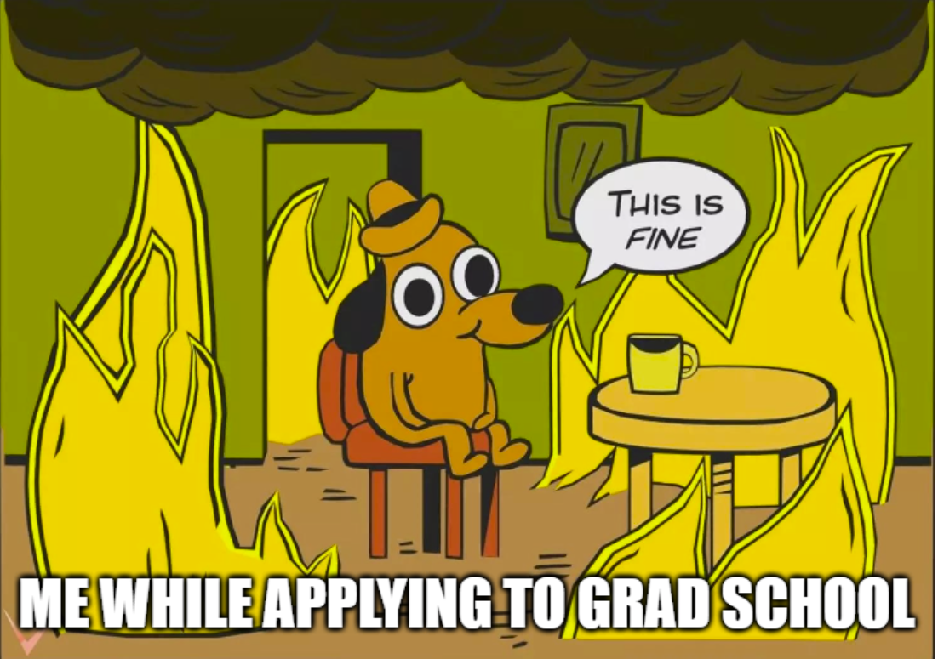
General Application Tips and Advice
Read up on every place you are applying to
Contact current grad students or faculty for more info
Start as early as possible
Write a little bit every day for your personal statement
Communicate with your peers that are applying so you can encourage each other
Find ways to healthily manage your stress.
Applying is a very stressful time so do take breaks to let yourself relax a little

Slide 19
Improving Your CV
In general, include all research, outreach, leadership, and teaching experience in your CV (organized into their respective sections)
The goal is to make your CV easily readable at a glance so things like your GPA and research experience should be towards the top.
Remember a CV is a living document of essentially your time in academia that also includes any conferences you presented work at , workshops you attended, talks you have given, posters, or papers you have published
For an in-depth guide, check out these slides I made here

Slide 20

Writing the Personal Statement

Slide 21
Tips for Writing Your Personal Statement
Write multiple drafts and possibly sections that can be used for different applications (different places have different requirements i.e. page and word limits).
Start as early as possible and revise often.
Your first draft can be rough and use it to just get your ideas out there.
Have your letter writers read it (people like them will be the ones reviewing it).
Have as many people as possible read it to give you as much feedback as possible.
Think about the most important things you want to include.
FOLLOW THE PROMPT!
DO NOT put your CV in essay form!

Slide 22

Things to include
Give specific reasons for why you are a good candidate for their program.
Talk about aspects of their program you like or facilities they have access to.
Talk about 2-3 faculty you are interested in working with and give some specifics of their work.
Talk about your research experience.
Give details on projects you worked on and what conclusions came from your work.
Show growth as a researcher or a student .
If you made a mistake or didn't do as well in a class, highlight how you've improved since then and show that those mistakes have made you a better candidate.
Talk about why you want to go to that specific program (why does it interest you).
Be positive!

Slide 23

Things to exclude or not do
Any sort of repetition (constantly edit this away).
Fluffy language like how you're amazed by the beauty of the universe (keep that to a minimum).
Don't avoid any weaknesses or shortcomings, talk about them and how you are working to overcome them (Show you address your issues head on).
Don't be overly critical or negative, address negative aspects, but don't linger on them, phrase in a way to show growth.
Don't undersell yourself (there's a lot more you can offer than you think!)

Slide 24
Examples?
Here are two examples from me (not the best but both are for places I was accepted)
UMD (marked with comments of things to hopefully help improve your essay)
UCSD (not marked but very similar layout to UMD)

Slide 25
Additional Material
Some applications have supplemental material over things like outreach, coding experience, leadership, etc.
Typically they break this off from the personal statement so you have less room there but "more room" to get specific in the additional material.
Make sure to only focus on the prompt.
Do not assume that they have just read your personal statement so make sure that the material stands on its own two feet.

Slide 26
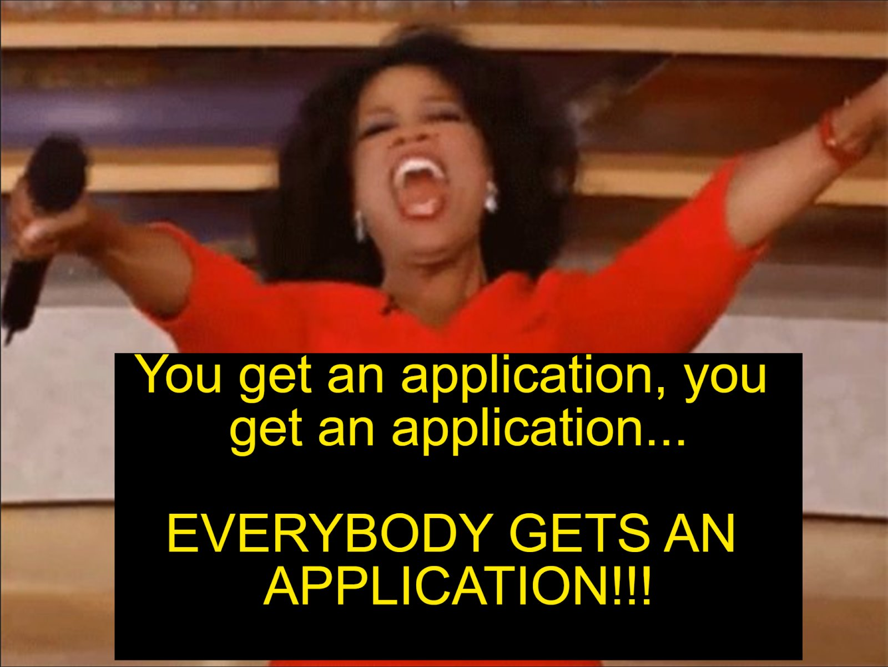
Final Checklist Before Submitting
Your transcript and CV have been uploaded.
Your personal statement is submitted.
Make sure you submit the right one!
Any additional material has been uploaded.
Your letter writers have submitted their letters.
Sometimes you have to submit before letters can be uploaded.
You've filled out the general information.
You've paid and hit submit.

Slide 27

Pause for Questions

Slide 28
Post Submission: The Waiting game
Take a deep breath, and save all of your application material for reference.
Finish the winter semester.
Do things to keep your mind off of waiting.
Make memes

Slide 29
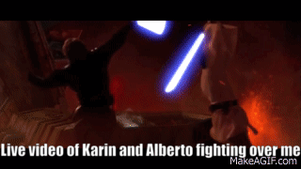
Post Submission: The Waiting game
Take a deep breath, and save all of your application material for reference.
Finish the winter semester.
Do things to keep your mind off of waiting.
Make memes

Slide 30
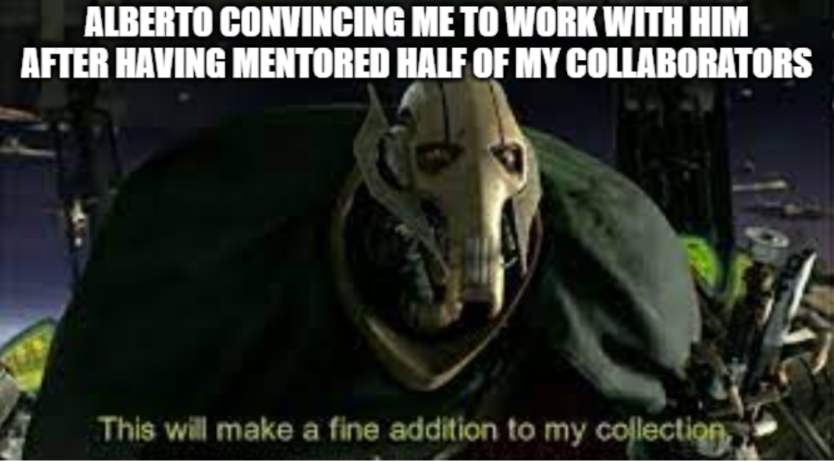
Post Submission: The Waiting game
Take a deep breath, and save all of your application material for reference.
Finish the winter semester.
Do things to keep your mind off of waiting.
Make memes

Slide 31
Grad School Interviews: How to prepare
Some schools will reach out to you in January or February to schedule an interview (mostly astro grad schools).
This is a really good sign! (you're on the short list!)
At the start, ask them about how many questions there will be.
Typically the whole thing lasts for 30 minutes, so pace yourself.
Have some questions of your own to ask at the end.

Slide 32
Common Question: Tell us about a research project you are working on.

Slide 33
Common Question: Why are you interested in going to grad school?
Give some department specific stuff for this answer!

Slide 34
Other Questions: What do you think a challenge will be for starting grad school?

Slide 35
Other Questions: What do you think your biggest strength is?

Slide 36

Getting Invited to Visit: What to Expect
Usually happens in March with a 2-3 day visit plus 1-2 travel days.
Tour of department and introduction to many of the faculty and grads.
The academic version of a 5 star athlete visit to a university.
Meals and travel typically covered.

Slide 37
Getting Invited to Visit: What to Expect
Expect to hear about all aspects of the program.
Usually 1-2 fun social events.
Lots of opportunities to ask questions.
Expect it to be jam packed.

Slide 38
Preparing for The Visit
Coordinate flights with their staff (they will reach out to you).
1
Reach out to faculty you are interested in working with to make sure you have time to chat with them.
2
Communicate with grad students there if there's specific things you want to hear about from them.
3
Pack niceish clothing (don't need anything too fancy but something to make a decent first impression in person).
4
Read about the area more to get an idea of things you would like to see if you have time.
5
Prepare to be exausted.
6

Slide 39
What to Look for During the Visit (Take Notes!)
Most important thing is: "are the grad students happy?
You should directly ask them this question (ask multiple students).
Also ask if they are unionized or feel they are treated fairly by the department and university.
Does the department seem to have a positive culture?
How active/invested are the faculty.
Do they have the programs you are interested in?
Things like outreach initiatives.
Second most important: "Can you see yourself living here?"
Climate and weather but also cost of living and the town/city itself.

Slide 40
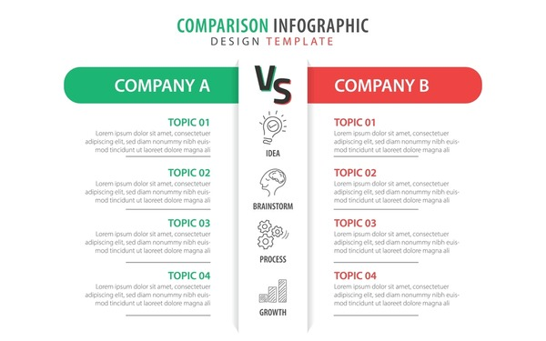
Making the Decision (The really hard part)
Consider things like research advisors, program overview, what grad students you vibe more with, cost of living, and where you can see yourself living for the next 5-7 years.
Make some comparison charts!
Literally make something like this!

Slide 41
What Do I Do The Summer Before?

Slide 42

Take Time Off!!!!!!!

Slide 43
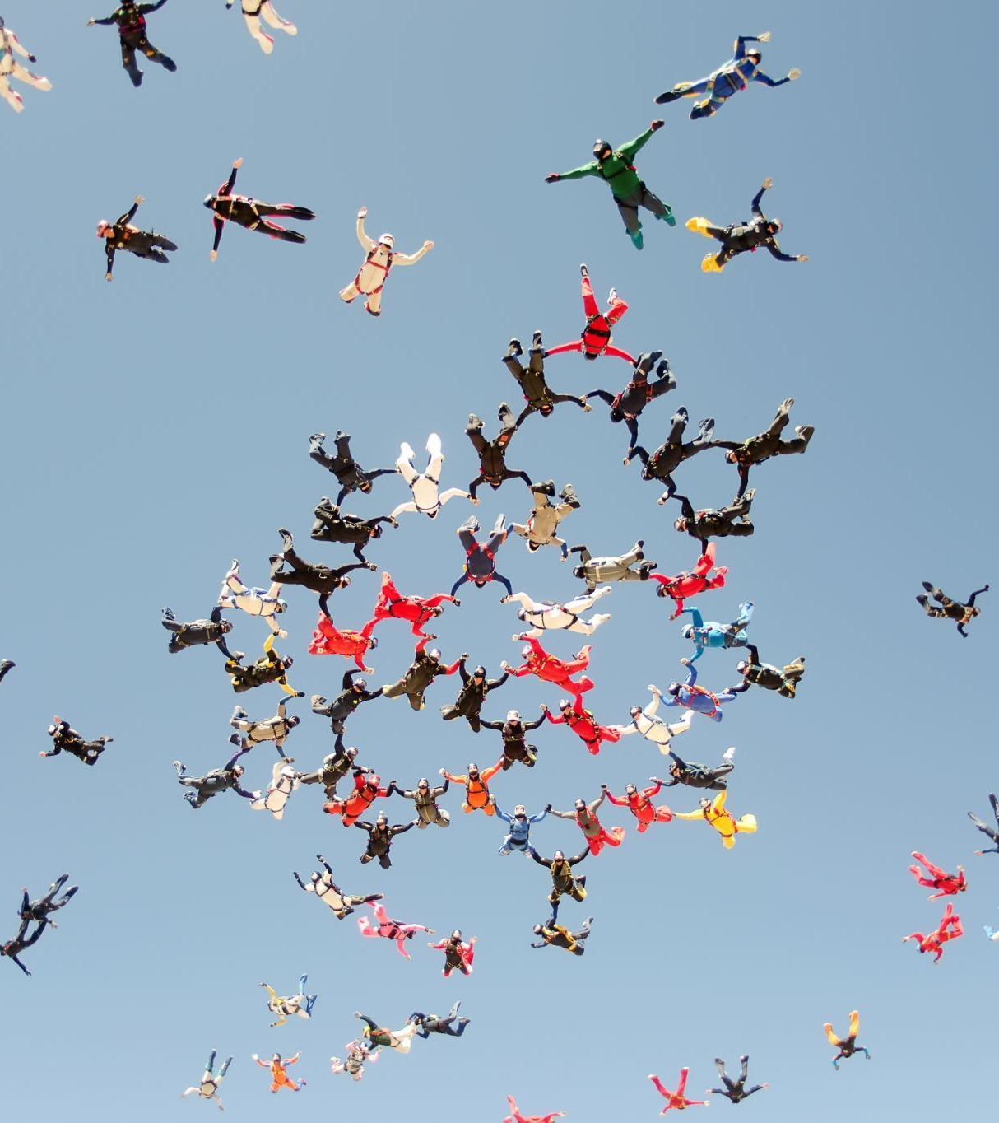
What to Do the Summer Before
Find a place to live.
Pack things to move.
Talk with advisors.
Do various orientation stuff and enroll.

Slide 44

Pause for Questions

Slide 45

Dealing with Rejection
Rejection is tough especially with how competitive getting into grad programs are
Most programs don't have anything higher than a 10% acceptance rate and that's on the high end
For astronomy the typical acceptance rate is around 3-5%
Getting rejected does not reflect your aptitude for being a good grad student! Every school unfortunately has to reject prospects even if the think they would do well.
With each rejection, you just need to take a deep breath and stay optimistic.

Slide 46
Dealing with All Rejections
Talk with your advisor about what you can do
Sometimes they will still work with you as a postbac or will recommend another program
Continue working to finish up a project you're working on
Apply to do research as a postbac in a lab
Go to industry for a few years
You'll make more money
Most importantly DO NOT GIVE UP!

Slide 47

Applying Again After Being Rejected
You can reapply every cycle
This gives you the opportunity to tighten your essays, make more research progress, and expand your CV to make yourself a more desirable candidate.
Applying to schools that previously rejected you is perfectly fine and encouraged!
Several grad students that I've met were rejected their first time and then got several acceptances when they reapplied.

Slide 48
Grad school is not a linear path. Each person's experience is different so don't compare yourself to your peers around you.

Slide 49


